Slide 1
NOTES ON A SCHOLARLY EXCHANGE IN THE JOURNAL
HIGH ABILITY STUDIES
MILLER ET AL. (2018) – ACCEPTED PRE-PUBLICATION VERSION
MILLER ET AL. (2019) – PUBLISHED VERSION
HAMBRICK AND MACNAMARA (2020) – COMMENTARY
MILLER ET AL. (2019) – PUBLISHED REPLY, REMOVED VERSION
MILLER ET AL. (2020) – PUBLISHED REPLY, REPLACEMENT VERSION

Slide 2
Miller et al. (2018) article,
Hambrick & Macnamara (2019) commentary
Scott Miller and colleagues performed a reanalysis of Macnamara et al.’s (2014) meta-analytic data; the re-analysis was submitted to and accepted for publication at High Ability Studies. Miller posted (Sept. 17, 2018) the “Prepublication Copy of article accepted for publication in High Ability Studies” on his website (still available as of Aug. 12, 2020).
Soon thereafter, we (Hambrick & Macnamara) began writing a commentary on the Miller et al. (2018) article, relying on this accepted pre-publication version. Because the Miller et al. (2018) article was still not published when we were ready to submit the commentary, Hambrick e-mailed (Nov. 8, 2018) the Editor of High Ability Studies (Prof. Dr. Albert Ziegler) to ensure the accepted prepublication version of Miller et al. that we had been relying on was the final version of the article (Hambrick included the link to the copy on Miller’s website). Editor Ziegler responded (Nov. 8, 2018) that there would be no changes in the Miller et al. (2018) article and that we could submit our commentary. Hambrick submitted the commentary (Nov. 14, 2018) and it was later accepted (April 9, 2019).
Subsequently, while checking quotations in the Hambrick and Macnamara (2019) galley proofs for accuracy, Hambrick discovered that, for whatever reason, Miller and colleagues did in fact make changes to the Miller et al. (2018) article, presumably at the galley proofs stage for their article. At least one change was substantive and affected a critical point that Hambrick and Macnamara had made in their commentary.
The same day, Hambrick e-mailed Editor Ziegler (April 16, 2019) to inform him of the situation. Editor Ziegler responded (April 16, 2019) to say that, if this report was correct, he would be “startled”; he also noted that Miller and colleagues had been informed that we (Hambrick & Macnamara) were writing a commentary on their article.

Slide 3
Miller et al. (2018) article,
Hambrick & Macnamara (2019) commentary
Next, Editor Ziegler sent (April 25, 2019) a document comparison to Hambrick (Miller et al. accepted version vs. published version) and noted he agreed “substantial” changes had been made. Confirming the changes had been made post-acceptance, he noted that because the changes were made at the production stage, they were out of his control; and he wrote: “that these changes had been made is obviously in line with the policy of the publisher. i was not aware of that, otherwise i had taken precautions. this is unfortunately a rare case.” He asked Hambrick how he would like to proceed.
After conferring with his co-author, Hambrick sent (April 30, 2019) Editor Ziegler an e-mail and corrected galley proofs for the Hambrick and Macnamara (2019) commentary detailing the changes that would need to be made to resolve the matter; this included quoting from both the accepted version and the published version of Miller et al. (2018) to show the important change Miller and colleagues made at the galley proofs stage.
Editor Ziegler responded (May 1, 2019) that he would need to consult with members of the journal’s board. Hambrick e-mailed (May 9, 2019) Editor Ziegler for an update, and Editor Ziegler responded (May 9, 2019) to say he was waiting for one outstanding opinion.
Three weeks later (May 30, 2019), with no resolution, Hambrick wrote Editor Ziegler to note that publication of their (Hambrick & Macnamara’s) commentary had now been delayed for 6 weeks, and wrote that if he (Hambrick) didn’t hear from him (Ziegler) in 2 weeks (by June 12, 2019) with suggested edits to the proposed changes, he would assume the changes were acceptable and would send them to the production office (copying Editor Ziegler). Hambrick attached the proposed changes again for Editor Ziegler’s convenience.

Slide 4
Miller et al. (2018) article,
Hambrick & Macnamara (2019) commentary
Editor Ziegler responded (May 30, 2019) to say that he was still waiting for the opinion of the aforementioned board member. Hambrick wrote back (May 30, 2019) to Editor Ziegler and reiterated that if he didn’t hear otherwise in 2 weeks (June 12, 2019), he would assume the proposed changes were acceptable to Editor Ziegler and would send the proof to the production office with approval for publication.
That date arrived with no response from Editor Ziegler, and Hambrick sent (June 12, 2019) the proof for the commentary back to the production office, copying Editor Ziegler on the email. Editor Ziegler was copied on all correspondence with the production office until publication of the commentary (Sept. 23, 2019).
The Hambrick and Macnamara (2019) commentary quotes from Miller et al.’s (2018) accepted pre-publication version and from the published version to show how Miller and colleagues changed their article, post-acceptance (see next slide). The commentary also notes that Miller et al. (2018) did not inform either the Editor of High Ability Studies or the authors (Hambrick & Macnamara) of these post-acceptance change. (We make no judgement about motives behind Miller and colleagues’ actions.)
If you would like the e-mails to confirm the preceding account of events, e-mail Zach Hambrick at hambric3@gmail.com and he will send them to you.

Slide 5
Miller et al. (2018) article,
Hambrick & Macnamara (2019) commentary
Text in accepted pre-publication version of Miller et al. (2018):
“To that end, we propose that in future studies, any activity deemed DP meet the following four criteria: (1) individualized learning objectives; (2) ongoing feedback regarding performance and learning; (3) involvement of a coach; and (4) successive refinement through repetition most often conducted alone (Ericsson & Lehmann, 1996). To this point, it is noteworthy that even work published by Ericsson, the researcher credited with originating the term, do not meet these four criteria and often change from one study or publication to another (c.f., Duffy, Baluch, & Ericsson, 2004; Ericsson et al., 1993; Ericsson, 2007; Plant, Ericsson, Hill, & Asberg, 2005; Tuffiash, Roring, & Ericsson, 2007).”
Text in published version of Miller et al. (2018):
“On this score, it is noteworthy that the definition of deliberate practice employed by Ericsson, the researcher credited with originating the term, has varied from one study or publication to another (c.f. Duffy, Baluch, & Anders Ericsson, 2004; Ericsson et al., 1993; Ericsson, Roring, & Nandagopal, 2007; Plant, Ericsson, Hill, & Asberg, 2005; Tuffiash, Roring, & Ericsson, 2007). To that end, after reviewing the various definition available in the literature, any activity deemed DP meet the following four criteria: (1) individualized learning objectives; (2) ongoing feedback regarding performance and learning; (3) involvement of a coach; and (4) successive refinement through repetition most often conducted alone (Ericsson & Lehmann, 1996 see Figure 1).”
The critical changes in the published version are (a) removal of the point that Ericsson’s own work does not meet the four criteria for deliberate practice, and (b) addition of the statement that they (Miller et al.) had reviewed the literature and found that activities deemed deliberate practice meet these criteria. (The paragraph is also rearranged.) These changes affected a point Hambrick and Macnamara had made in their commentary. We make no judgment about why Miller and colleagues made these changes.

Slide 6
Miller et al. (2019/2020) reply to
Hambrick & Macnamara (2019) commentary
On November 8, 2019, Miller and colleagues published the following reply to the Hambrick and Macnamara (2019) commentary:
Miller, S. D., Chow, D., Wampold, B., and Hubble, M. A. (2019). “You say tomatoe, I say tomawto”: the importance of deliberate practice for improved performance. High Ability Stud. 30, 288–290. doi: 10.1080/13598139.2019.1652542
[On Dec. 18, Hambrick sent an e-mail to Editors Ziegler and Harder noting that in their reply Miller et al. (2019) had not resolved a coding error in their meta-analysis that rendered their results uninterpretable. Hambrick also noted that the Miller et al. (2019) reply had apparently not been copy edited (e.g., “expertise” was spelled as “expertize” in two places.)]
More than 8 months later, on July 24, 2020, the Miller et al. (2019) reply was replaced with a different reply:
Miller, S. D., Hubble, M. A, Chow, D., and Wampold, B. (2020). More confusion about deliberate practice? Not really. High Ability Stud. 295-297, 30, 295-297. doi: 10.1080/13598139.2020.1780004
On the next slide are screenshots of the original reply (2019) and its replacement (2020), and of a “statement of removal”…

Slide 7
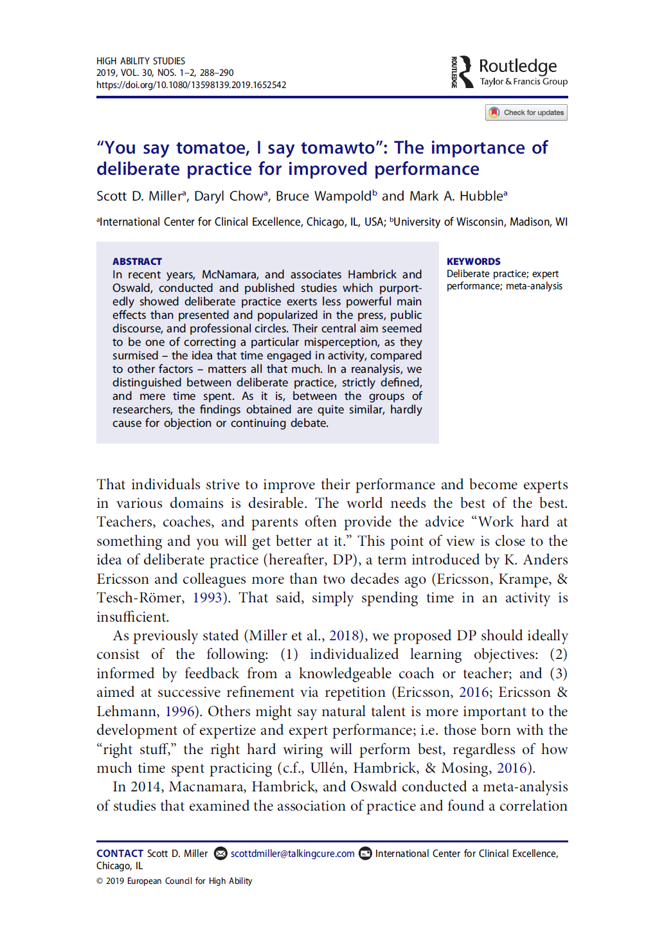
Screenshot of original Miller et al. reply,
published on Nov. 8, 2019
Screenshot of replacement reply, published more than 8 months later,
on July 24, 2020

Slide 8
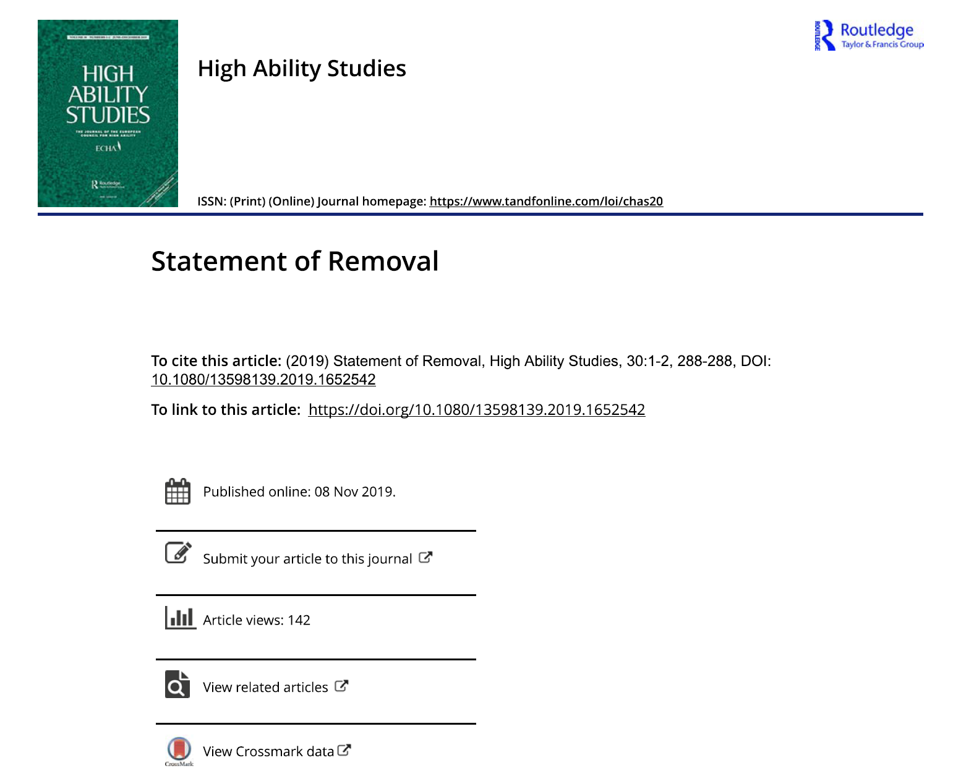
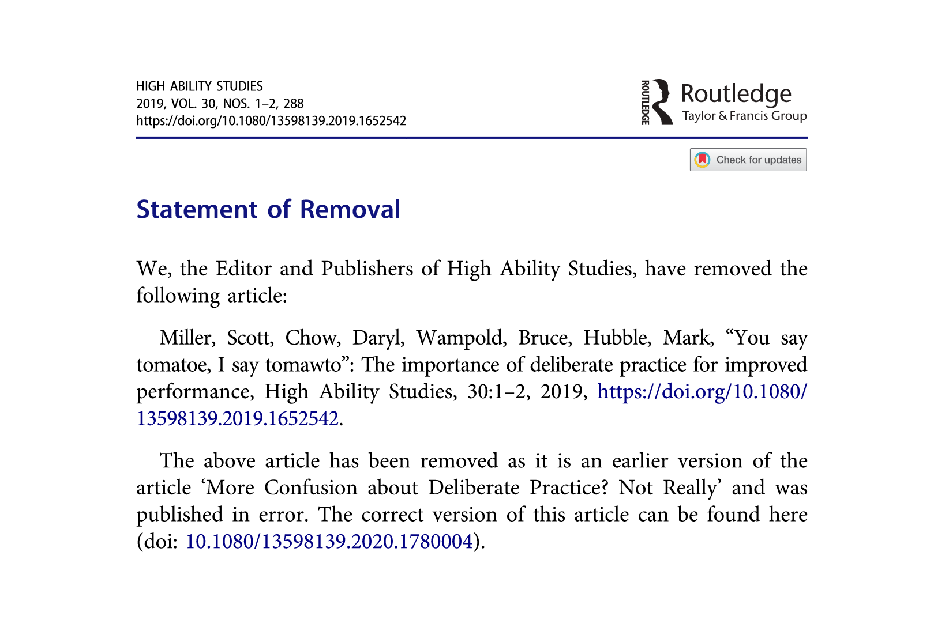
Nov. 8, 2019 was the publication date for the original reply; it is also listed as the publication date for the statement of removal.
However, this cannot be correct, because the statement of removal refers to the replacement article, which wasn’t published until July 24, 2020, more than eight months later.
[Thus, the Nov. 8 date in the statement of removal presumably refers to when the original (now removed) article was published, not the removal date.]

Slide 9
Citation of Miller et al.’s (2019) original reply in Hambrick et al. (2020) Frontiers article
In the Hambrick et al. (2020) Frontiers article, we include two quotations from the original version of Miller et al.’s (2019) reply. This was the reply that was available to us while we were writing our article; we did not learn of the replacement version until after our Frontiers article was accepted and it was too late to change the article. Therefore, with the approval of the Editor of our Frontiers article (Ben Cowley), we here will detail how the removal-replacement of Miller et al.’s (2019) reply affects our article.
Quotation from the original version of the Miller et al. (2019) reply in our Frontiers article (p. 8):
“Still, something about our analyses [Miller et al., 2018, reanalysis] was displeasing to [Hambrick and Macnamara, 2019a]”
In the Miller et al. (2020) replacement version, this reads:
“Still, something about our analysis [Miller et al., 2018, reanalysis] incurred the disapproval of Hambrick and Macnamara (2019).”

Slide 10
Citation of Miller et al.’s (2019) original reply in Hambrick et al. (2020) Frontiers article
Quotation from the original version of the Miller et al. (2019) reply in our Frontiers article (p. 8):
“The central question of both studies was the role played by deliberate practice in the acquisition of expertize [sic]. One might think there would be a ‘meeting of the minds’ when the estimates from their analysis and ours returned such similar results” (p. 289).
In the Miller et al. (2020) replacement version, this reads:
“Looking more closely at the two meta-analyzes [sic], the central question of both was the role deliberate practice plays in the acquisition of expertise. One might think there would be a ‘meeting of the minds’ when the estimates of the two studies returned such similar results”

Slide 11
Citation of Miller et al.’s (2019) original reply
in Hambrick et al. (2020) Frontiers article
In the replacement version of their reply, Miller et al. (2020) also add a comment about the post-acceptance changes they made in the Miller et al. (2018) article. Footnote 3 states:
“Hambrick and Macnamara are correct in pointing out that a change was made in our article after it had been accepted for publication. While reviewing the galley proof, we asked and were granted permission by the editors to include a figure. Its purpose was to provide a visual reference for understanding our proposed criteria for evaluating studies of deliberate practice (see Figure 1, p 8 Miller et al., 2018]. Unfortunately, during the insertion of the figure, five words were inadvertently omitted from the description of the criteria, resulting in a grammatically incorrect and incomplete sentence. The last sentence in the article should read, ‘To that end, we propose that in future studies, any activity deemed DP meet the following four criteria: (1) individualized learning objectives; (2) ongoing feedback regarding performance and learning; (3) involvement of a coach; and (4) successive refinement through repetition most often conducted alone.’ Given Hambrick’s close involvement throughout the review process, we would have appreciated being notified so the obvious error could have been corrected and any misunderstandings and untoward characterizations avoided.”
When Miller et al. (2018) state they were “granted permission by the editors” (above) to add a figure, they must be referring to the copy editors at the publisher rather than to the journal’s editors (i.e., Editor Ziegler and Associate Editors), given that Editor Ziegler had indicated to Hambrick there would be no further changes in the article from the accepted prepublication version. Hambrick contacted the Editor Ziegler (rather than the authors) upon discovering the changes. We make no judgement about motives behind Miller and colleagues’ actions in this matter.

